Slide 1
UNIT – III (ENGINEERING PHYSICS)
Introduction to Quantum Mechanics

Slide 2
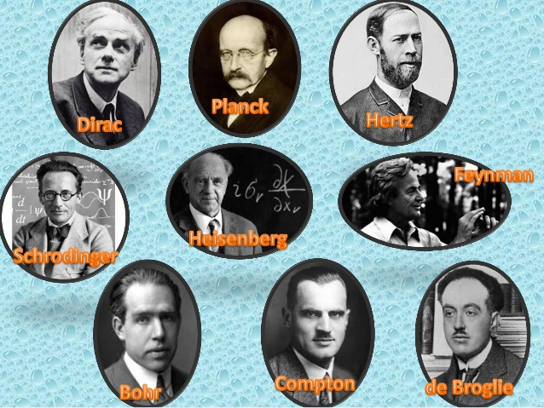
Pioneers of Quantum Mechanics

Slide 3
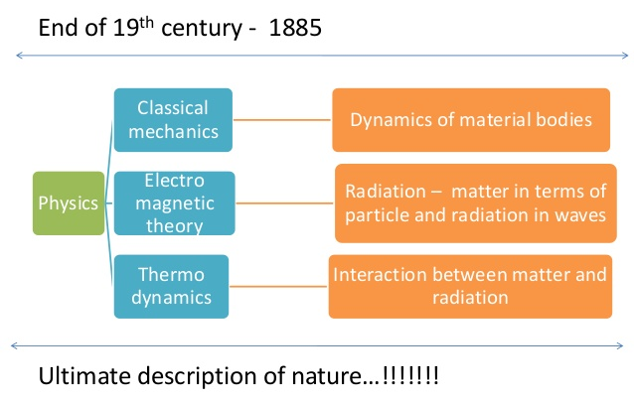

Slide 4
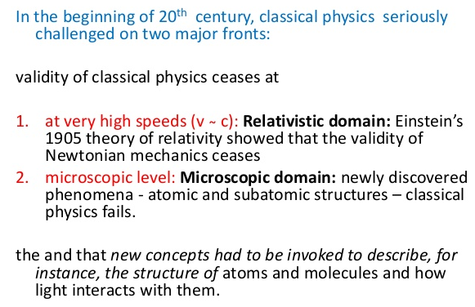

Slide 5
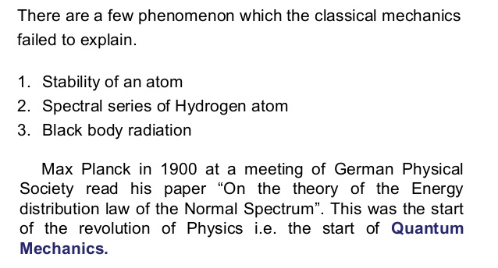

Slide 6
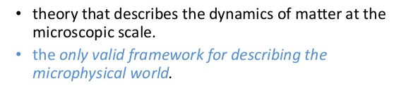
Quantum Mechanics (Q.M.)

Slide 7
Max Planck proposed a formula for the intensity curve which did fit
the experimental data quite well.
Instead of allowing energy to be continuously distributed among
all frequencies, Planck proposed that the energy in the atomic vibrations of
frequency (ν) was some integral times a small, discrete energy i.e.
E= nhν
where n in an integer, n = 1, 2, 3, . . .
h =Plank’s constant = 6.626176 x 10⁻³⁴ J s
This idea that something -- the energy in this case -- can have only
certain discrete values is called quantization. We say that the energy
is quantized. This is referred to as Planck's quantum hypothesis.
Einstein used very similar ideas to explain the Photoelectric Effect in 1905,
that it was realized that these assumptions described "real Physics"

Slide 8
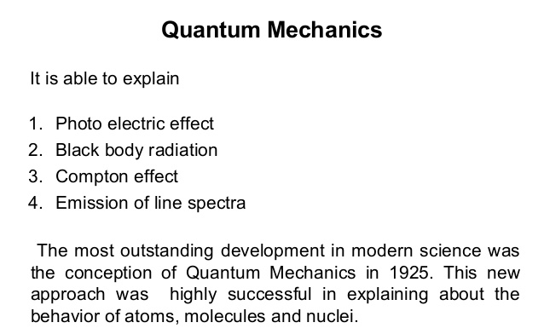

Slide 9
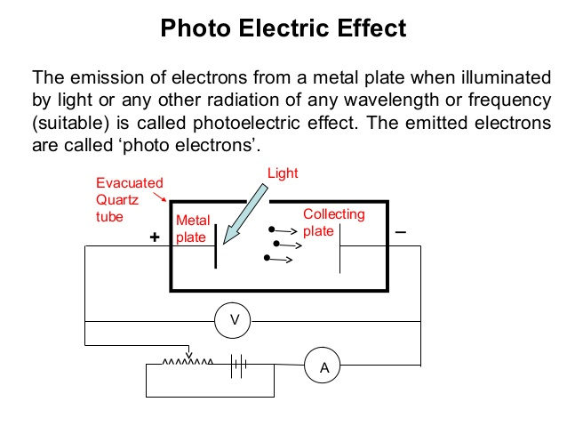

Slide 10
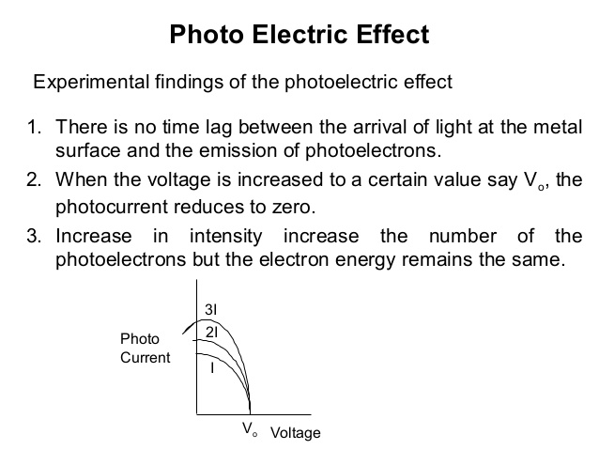

Slide 11
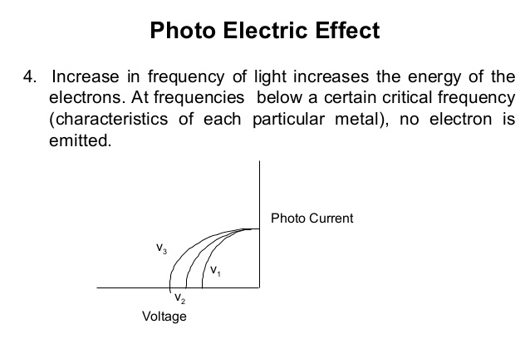

Slide 12
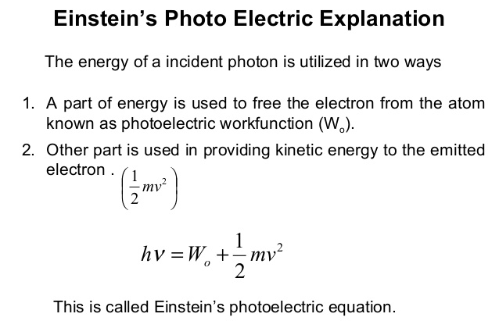
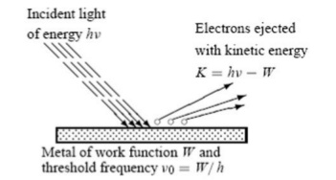
Photoelectric effect: When a metal is irradiated with a light, electron may emitted.

Slide 13
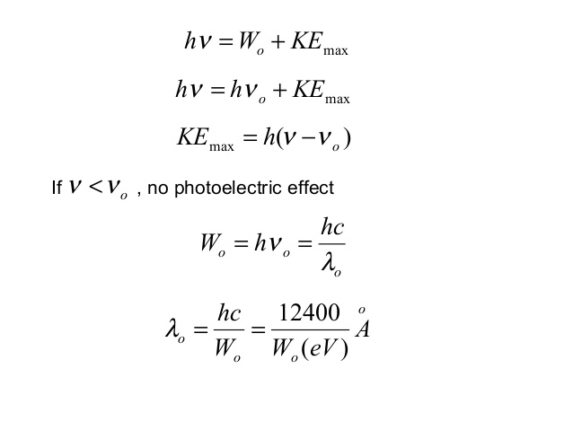
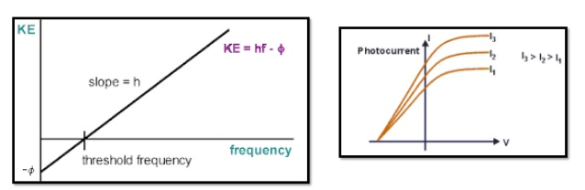

Slide 14
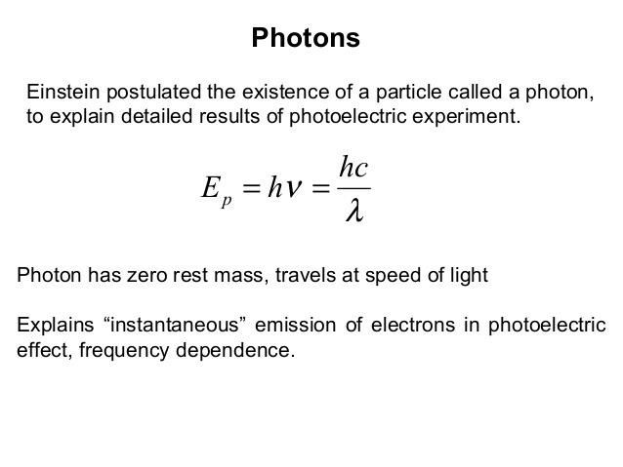

Slide 15
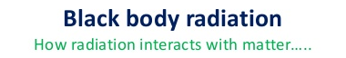
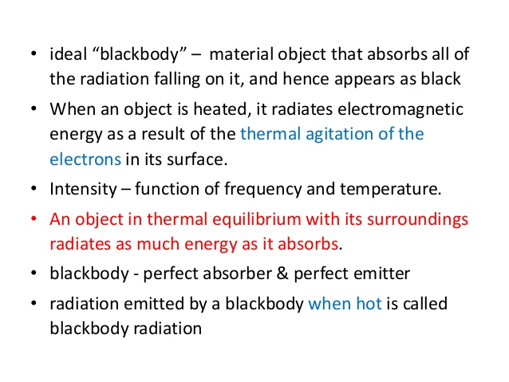
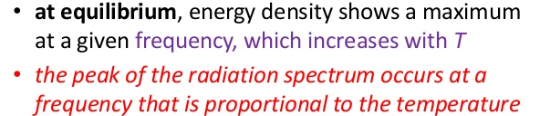

Slide 16
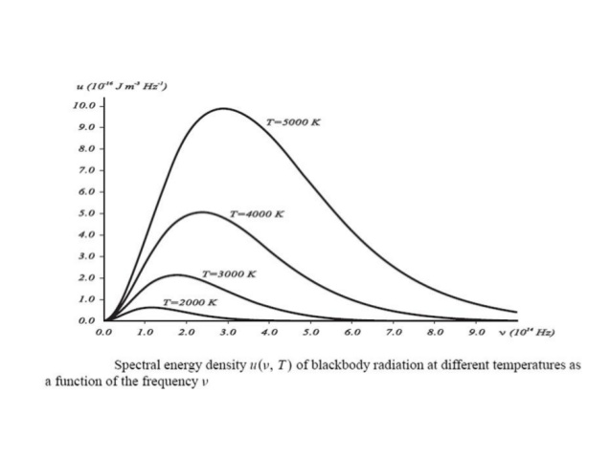

Slide 17
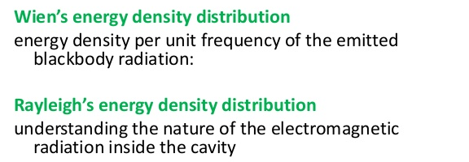
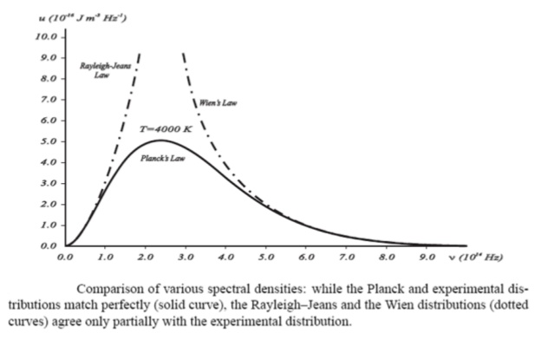

Slide 18
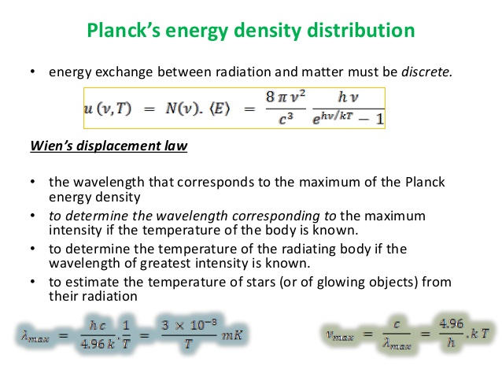

Slide 19
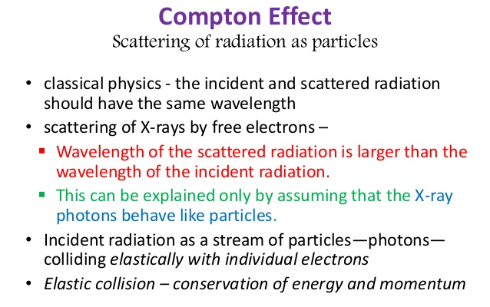

Slide 20
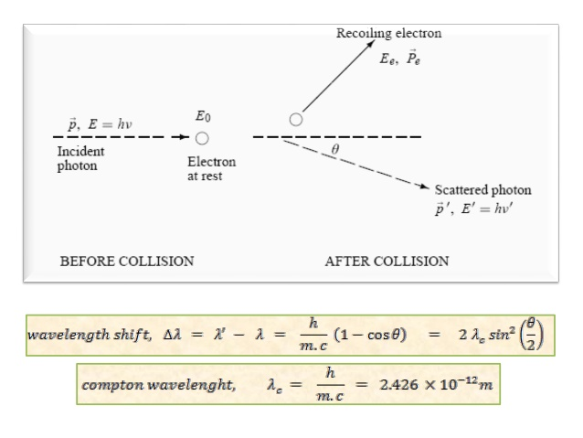

Slide 21
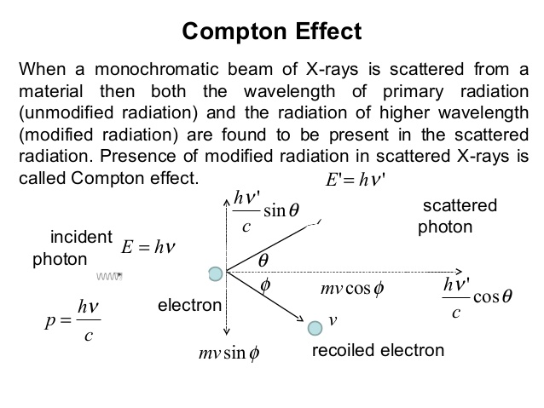
Derivation is not necessary, but here it is included (slide no. 20 – 25)

Slide 22
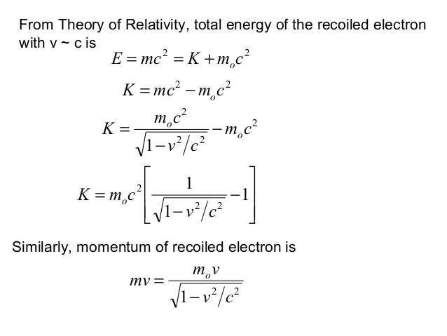

Slide 23
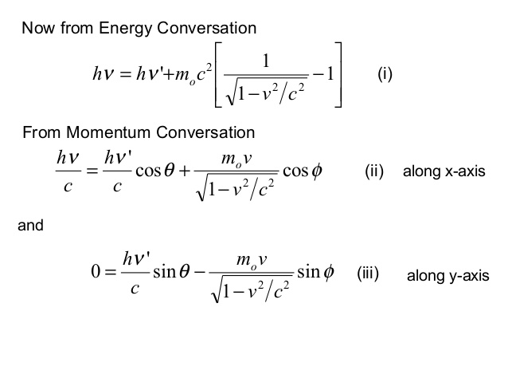

Slide 24
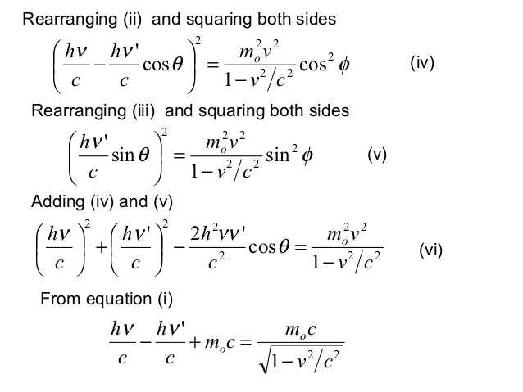

Slide 25
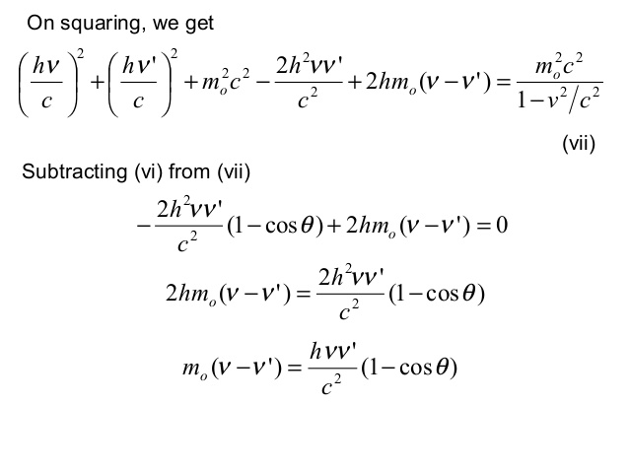

Slide 26
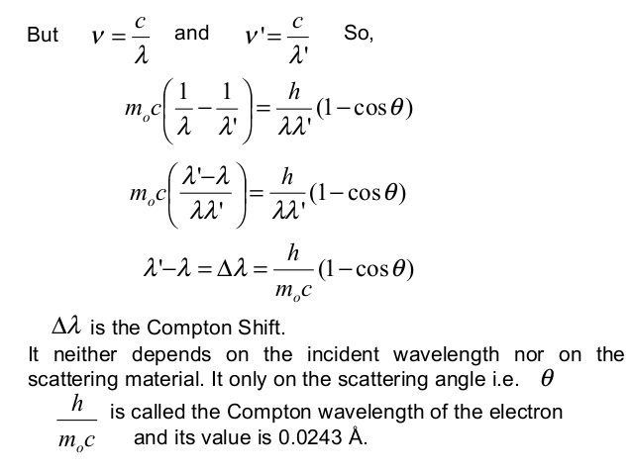

Slide 27
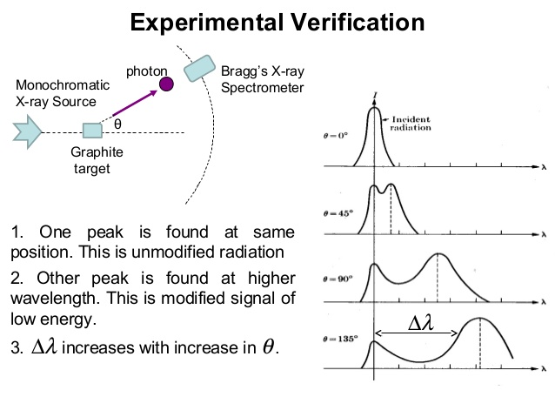

Slide 28
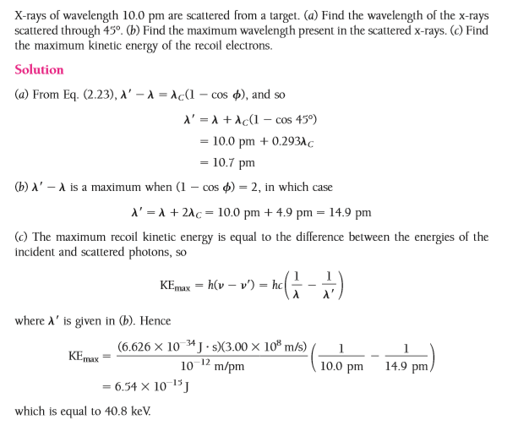
Q.

Slide 29
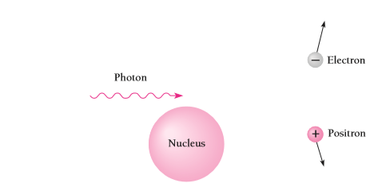
Pair Production: Energy into Matter
Photon is materialised into an electron and a positron (positively charged electron). The process is known as Pair Production.
Also it is known as the conversion of e.m. energy into matter.
No conservation principles are violated during the process.
Pair-production can’t occur in free space.

Slide 30
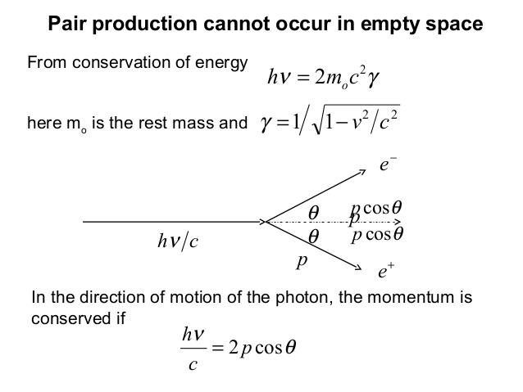

Slide 31
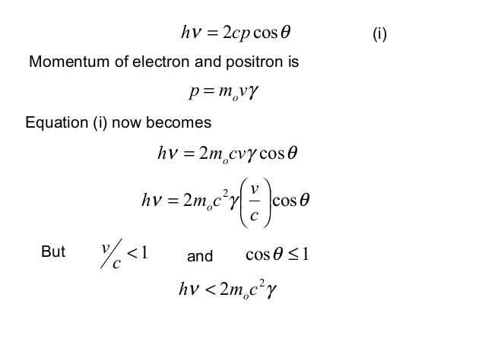

Slide 32
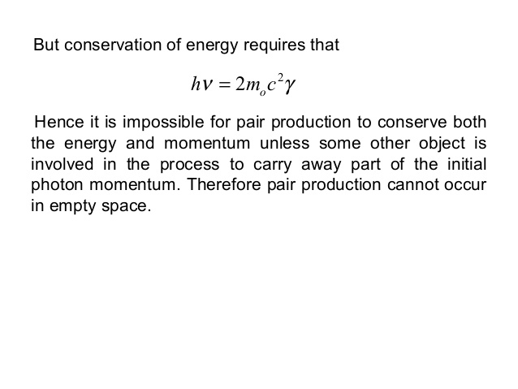

Slide 33
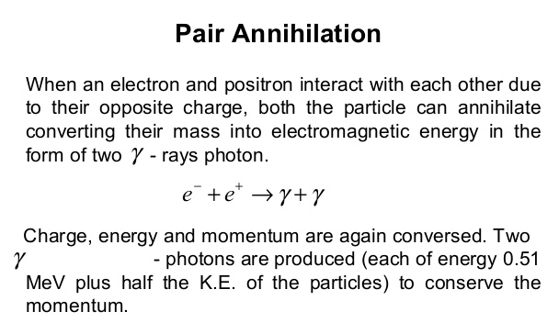
It is the inverse of pair production

Slide 34
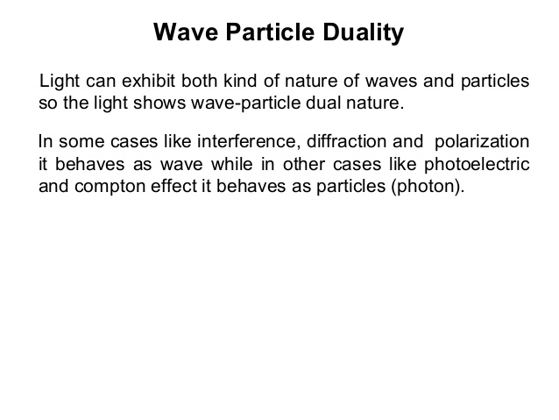

Slide 35
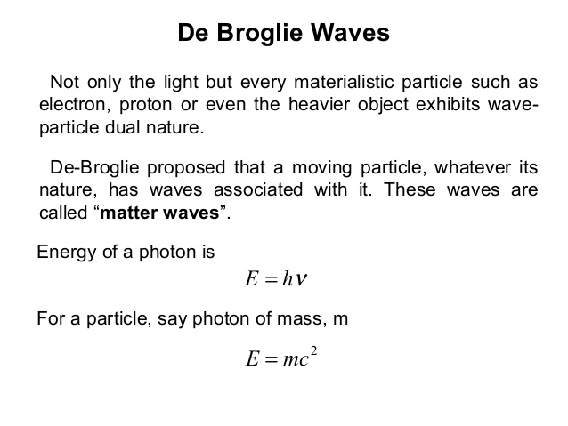

Slide 36
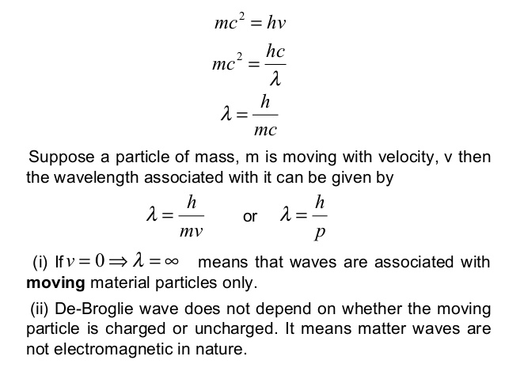

Slide 37


Q. What is the de Broglie wavelength of an 1100-kg automobile moving at 10 m/s?
Solution:
The diameter of an atomic nucleus is only about 10 ⁻ ¹⁴ m so a wavelength
of 10⁻³⁸ m is immeasurably small! We can never expect to measure
anything this small.

Slide 38
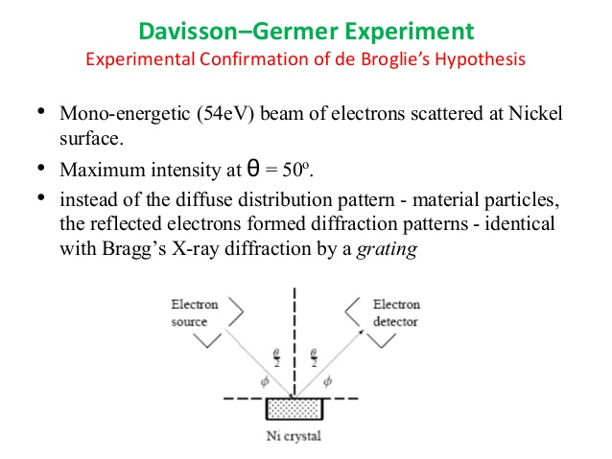

Slide 39
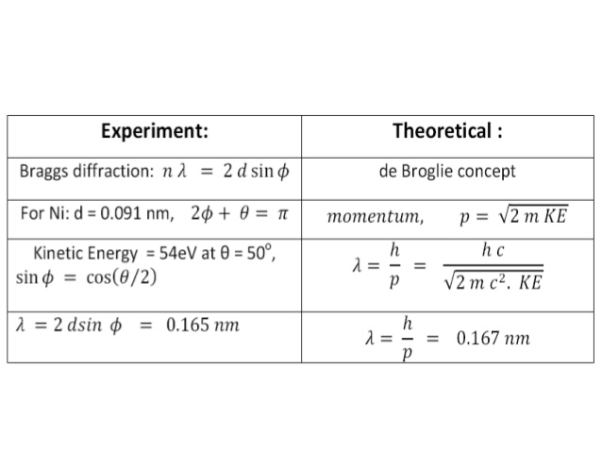

Slide 40
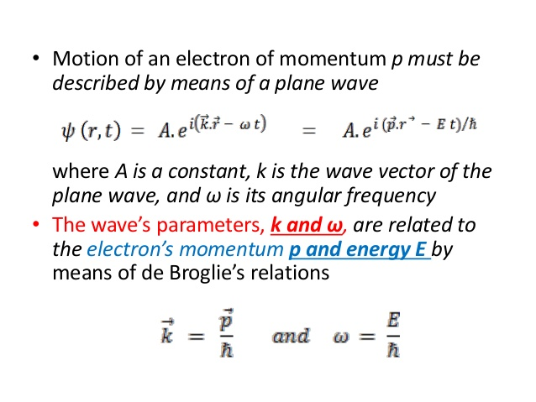

Slide 41
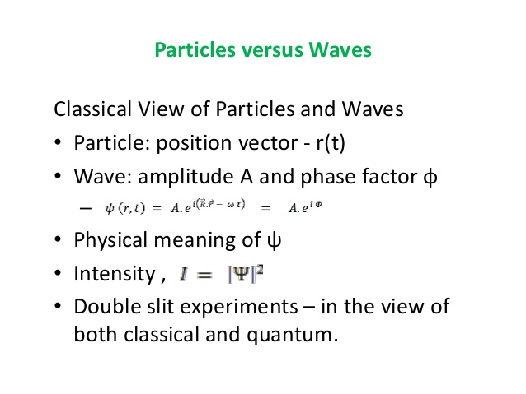

Slide 42
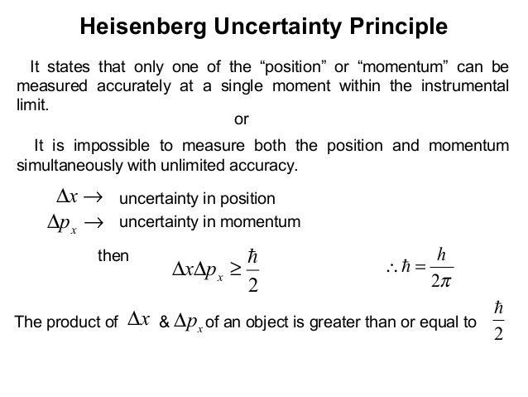

Slide 43
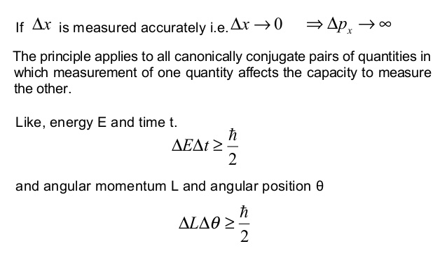

Slide 44
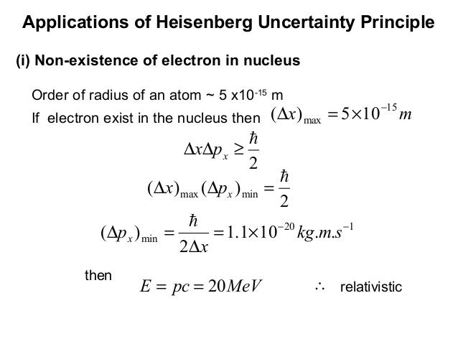
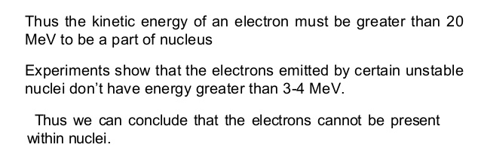

Slide 45
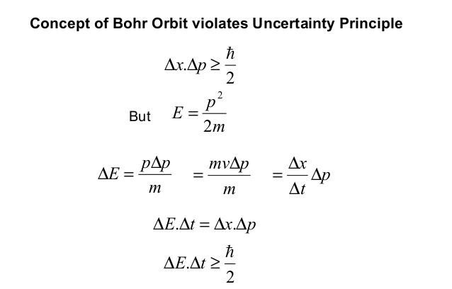
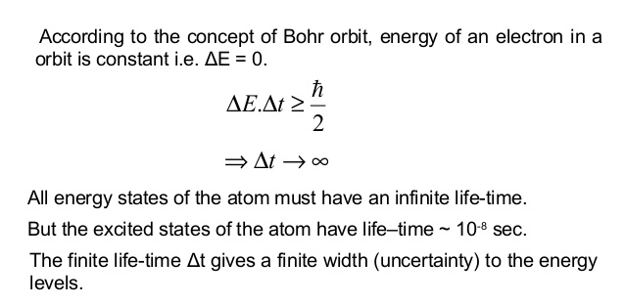

Slide 46
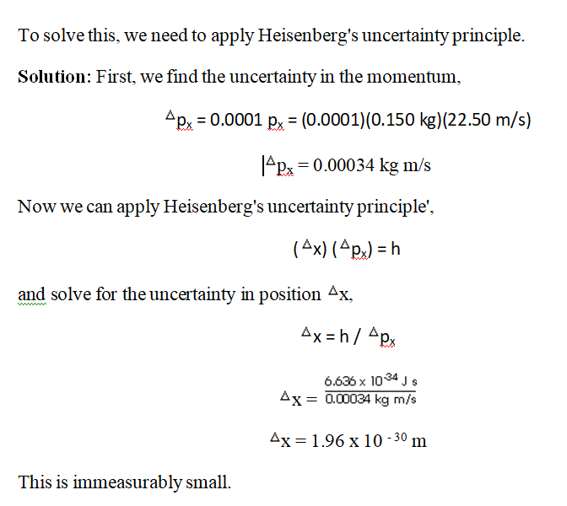
Q. The velocity of a 0.150 kg baseball is measured to be 22.50 m/s with an accuracy of 0.01%. How accurately can its position be determined?

Slide 47
Some numerical will be discussed/shared in due course of time.
Also, the remaining topics of the Unit – II i.e., E.M. Energy Density and the Poynting Theorem will be discussed/provided at a later stage.

Slide 48
Thank You

